Slide 1
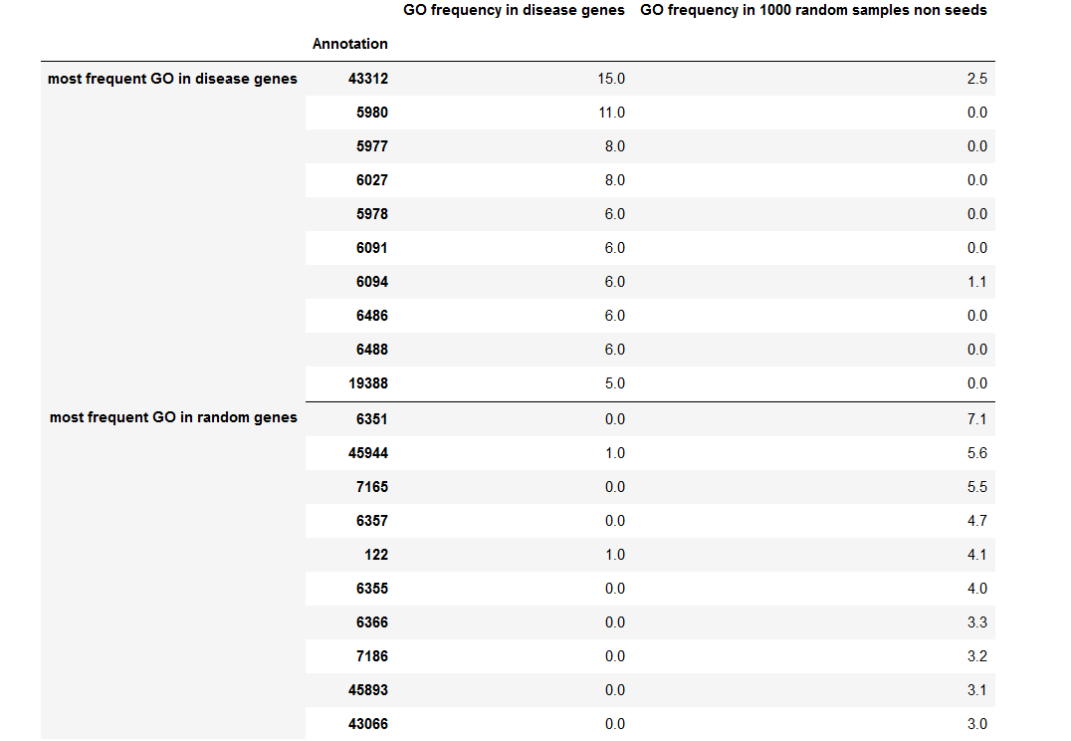
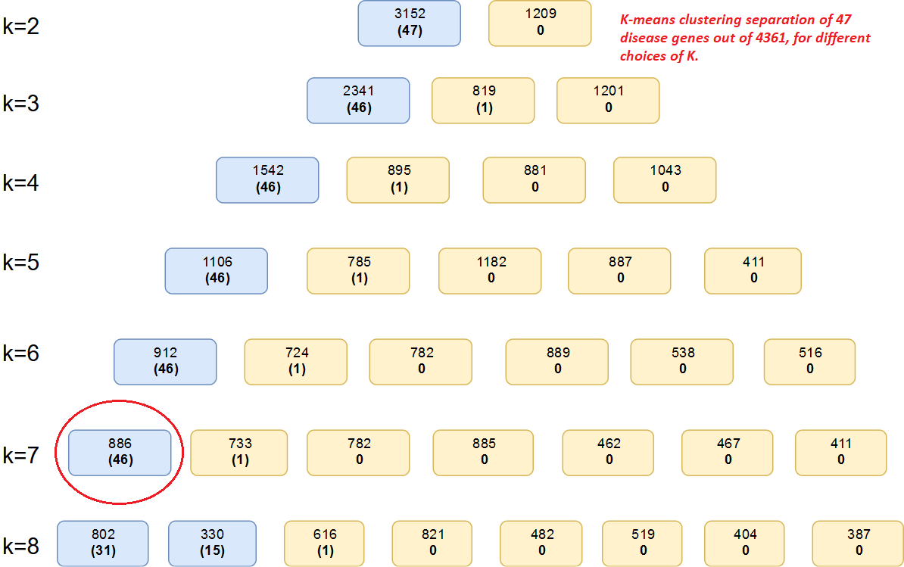
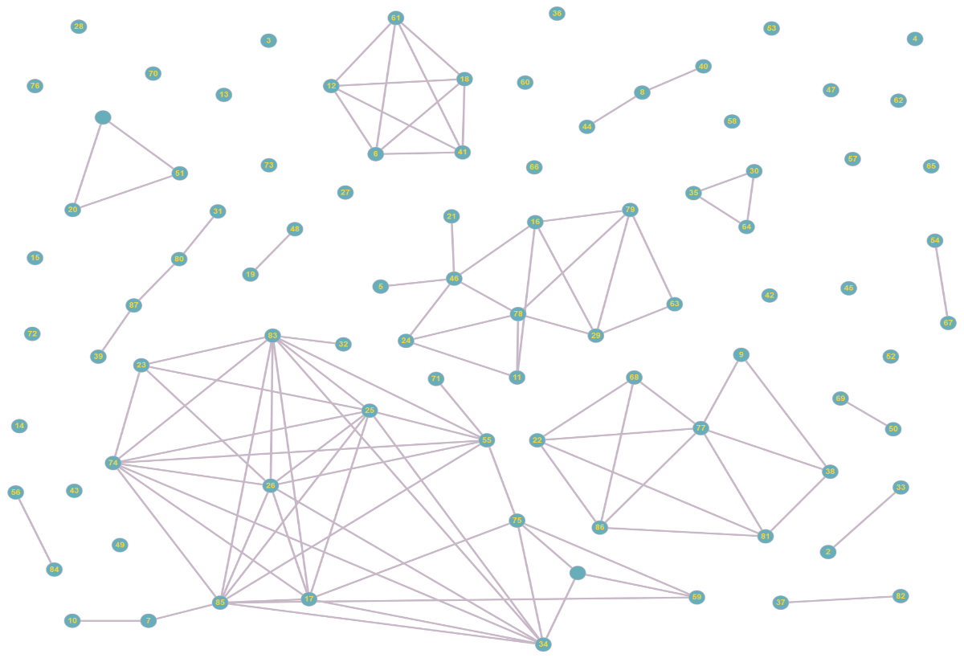


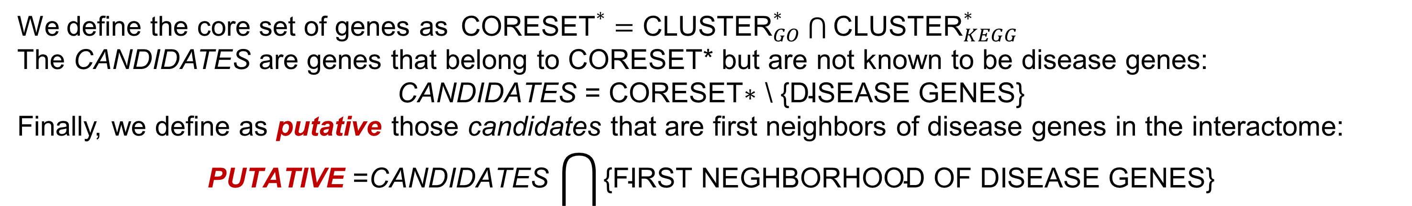
Annotation Driven Optimized Clustering
for Disease Genes Batch Identification
1. Introduction
It is still uncertain if disease genes have unique properties that distinguish them from other non-disease genes or, from a network perspective, if they are located randomly in the interactome or they show some kind of patterns in the network topology, as for instance hubs or modules.
In order to identify such patterns of disease genes we propose a novel top-down approach which uses two kinds of database annotations: GO terms (Gene Ontology - Biological Process) and KEGG pathways.
2. Selection of Meaningful Information
3. Optimized Clustering Phase
For each database and each disease, given the P disease genes, we consider the N (=10) most frequent annotations in the disease genes.
Further we identify other N(=10) annotations among the most frequent in sets of non-disease genes of cardinality P. In this respect we extract from the interactome - excluding the P disease genes - M (=1000) subsets of genes of cardinality P and we count the occurrence of each annotation.
The N annotation with highest occurrence average together with the N annotations with highest frequency in the disease genes give us the set of annotations (of cardinality 2N) that are used in the clustering phase of the method.
We construct the (13458 x 2N) incidence matrix $A$of the interactome according to the extracted 2N annotations:
$$A_{ij }=\left\{\begin{aligned}−&1, if gene i contains annotation j \\ &0, otherwise\end{aligned}\right.$$
After we applied a k-means clustering algorithm using as features the rows of matrix $A$(cleaned up by zero rows$)$.
The number of clusters k is increased incrementally by one, starting with k=2. We end up with the number of cluster k_{max} which is the maximum number of clusters such that at least the 90% of disease genes belong to the same cluster.
By this procedure, we select the sets CLUSTER_{i}* i=GO, KEGG, having the highest number of disease genes.
4. Selection of Putative Genes
We define the core set of genes as${\text{CORESET}}^{∗}={\text{CLUSTER}}_{GO}^{∗}\bigcap{{\text{CLUSTER}}_{KEGG}^{∗}}$
The CANDIDATES are genes that belong to CORESET* but are not known to be disease genes:
$$\text{CANDIDATES} \text{= }\text{CORESET}\text{∗ \backslash \{}\text{DISEASE} \text{GENES}\text{\}}$$
Finally, we define as putative those candidates that are first neighbors of disease genes in the interactome:
$$\text{PUTATIVE} \text{=}\text{CANDIDATES} \bigcap{\text{\{}\text{FIRST} \text{NEGHBORHOOD} \text{OF} \text{DISEASE} \text{GENES}\text{\}}}$$
5. Validation and Numerical Testing
We generated 100 replicates by selecting randomly 70% of the seed genes. We tested our algorithm on the Ghiassan et al. dataset on Carbohidrate metabolism inborn errors and on Breast neoplasm obtaining always consistent results thus proving robustness of the approach. Further work will be devoted to perform biological validation of the results and in vitro experiments.
Putative
unknown
putative
(known for
other
diseases)
Department of Computer, Control and Management Engineering Antonio Ruberti, (DIAG)
Dipartimento di Scienze Statistiche (DSS)
Federico Francone
Marianna De Santis
Stefano Lucidi
Paolo Dell’Olmo
Lorenzo Farina
Laura Palagi
International Conference on Network Medicine and Big Data:
the Transformation of Medicine
Notes:
BATCH BCD:
1

